Slide 1
Traffic Signalization
Traffic Engineering and ITS
Prof. Gaetano Fusco
Project done by
Sai Arvind Atluri
Shailesh kumar
Revathi Vamshi

Slide 2
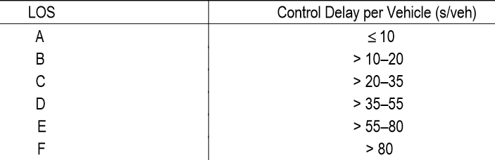
Objectives
Identify the Level of Services(LOS) of 6 road intersections
Optimize those intersections
Synchronize them to compute ideal traffic conditions.

Slide 3
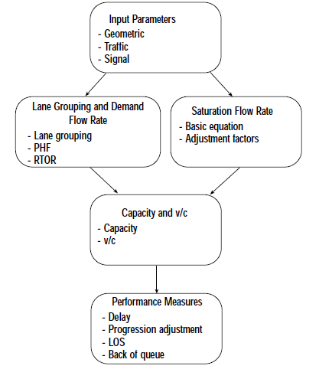
Methodology

Slide 4
Methodology
Highway Capacity Manual
Optimization phase
Synchronization phase

Slide 5
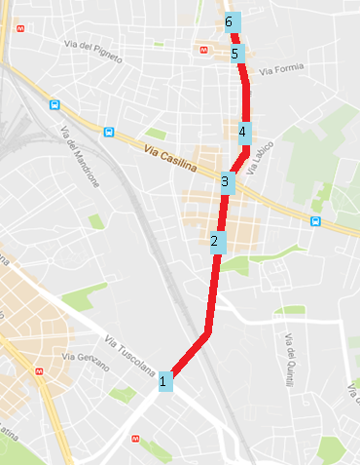
Study Area-Municipio Roma V
Our study area was plotted on Municipio Roma V extended from via Tuscolana – via di porta furba to via di acqua bullicante – via aversa. We took 6 intersections between the route. It is not a major enough route in the Rome to have a bicycle path or a bus stop but have a decent vehicular flow through the route.

Slide 6
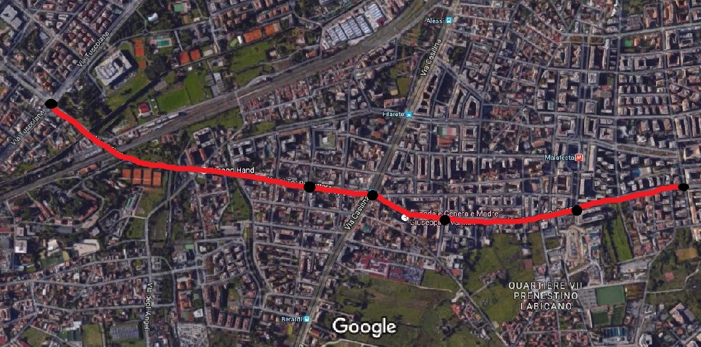
Study Area-Municipio Roma V
1
2
6
3
5
4
SI.no. | Road Intersection
1 | Via Tuscolana- via di porta furba
2 | Via Pietro rovetti -via di tor pignattara
3 | Via Casilina – via di acqua bullicante
4 | Via Policastro – via di acqua bullicante
5 | Via Roberto malatesta – via di acqua bullicante
6 | Via Aversa – via di acqua bullicante

Slide 7
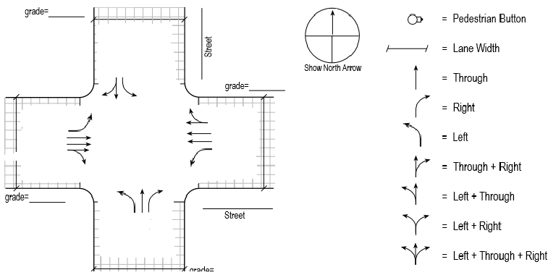
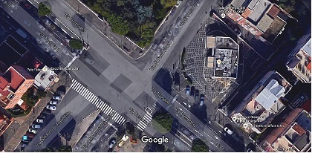
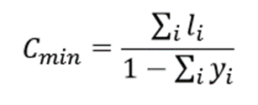
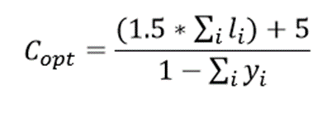
Intersection 1
 | EB | WB | NB | SB
Delay by approach | 114.67 | 121.70 | 44.80 | 28.33
LOS by approach | F | F | C | D
Approach flow rate, Va | 1178 | 1183 | 857 | 550
Intersection delay | 88.39
Intersection LOS | F

Slide 8
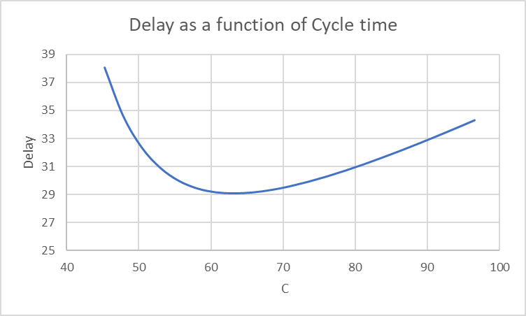
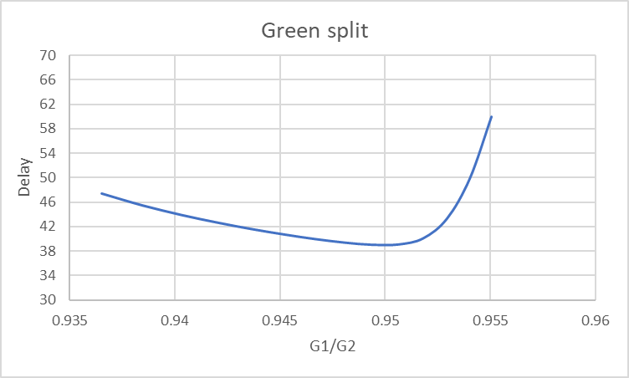
Intersection 1
g1 | 39
g2 | 41
g3 | 25
Actual Cycle Length | 117
Actual Delay | 88.39
LOS | F
After Optimisation
C | 63.219
Delay | 29.0851
LOS | C
G1/G2 | 0.9493
Delay | 39.068
LOS | D

Slide 9
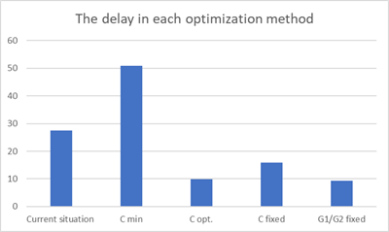
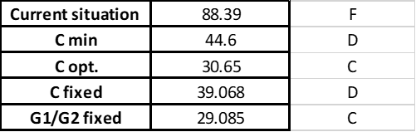
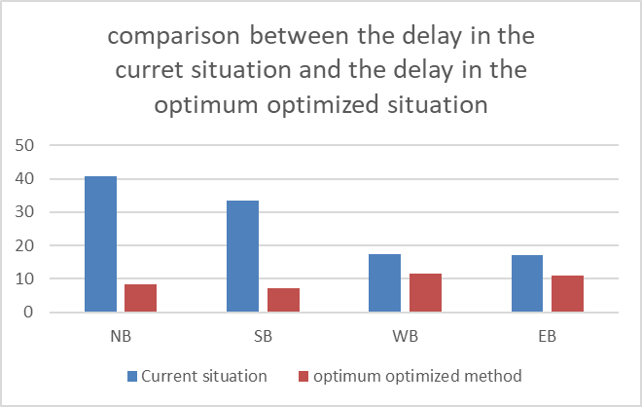
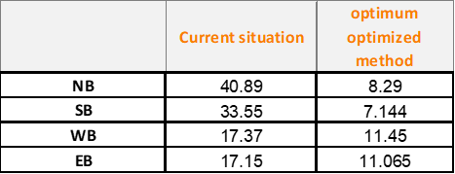
Intersection 1

Slide 10
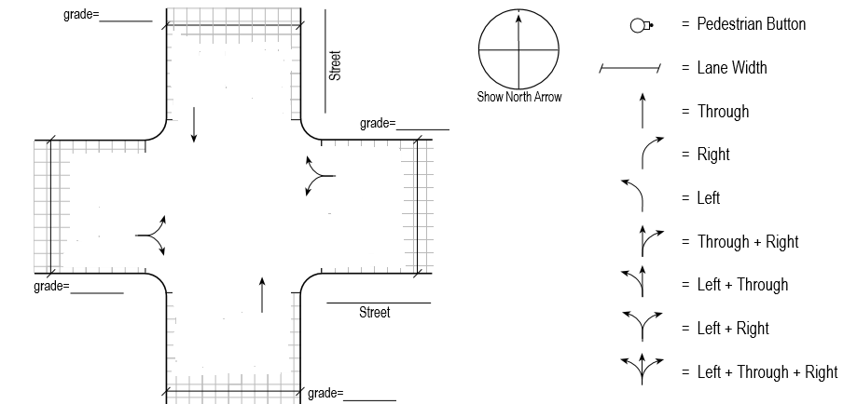
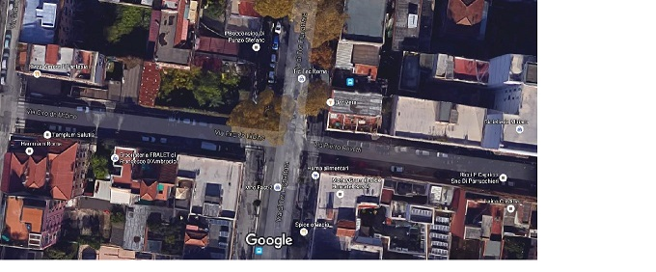
Intersection 2
 | EB | WB | NB | SB
Delay by approach | 17.15 | 17.37 | 40.89 | 33.55
LOS by approach | B | B | D | C
Approach flow rate, Va | 186 | 200 | 294 | 206
Intersection delay | 27.48
Intersection LOS | C

Slide 11
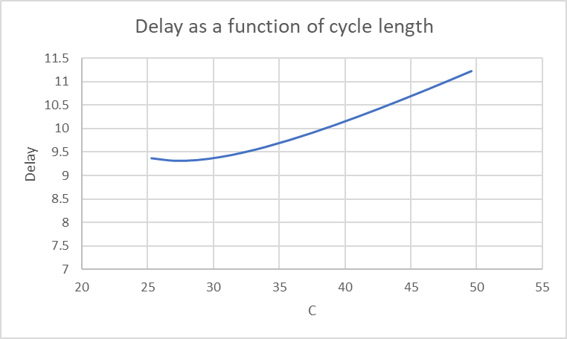
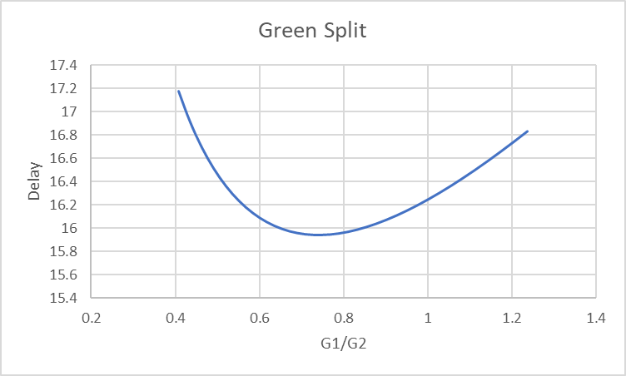
Intersection 2
g1 | 33
g2 | 45
Actual Cycle Length | 86
Actual Delay | 27.48
LOS | C
After Optimisation
C | 27.06
Delay | 9.3193
LOS | A
G1/G2 | 0.7272
Delay | 15.9454
LOS | B

Slide 12
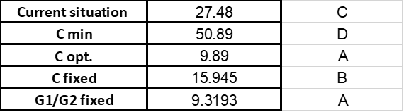
Intersection 2

Slide 13
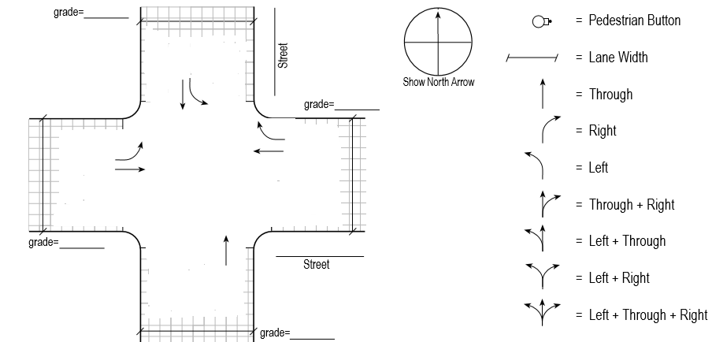
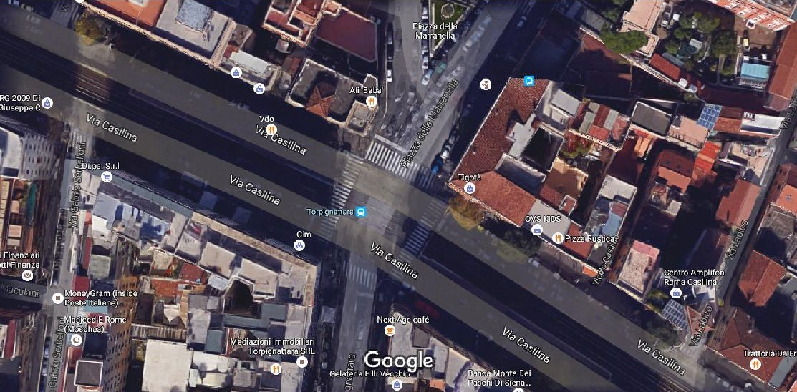
Intersection 3
 | EB | WB | NB | SB
Delay by approach | 26.74 | 25.90 | 105.19 | 285.53
LOS by approach | C | C | F | F
Approach flow rate, Va | 300 | 244.4 | 172.2 | 277.7
Intersection delay | 45.30
Intersection LOS | D

Slide 14
Intersection 3
G1 | 76
G2 | 17
ACTUAL CYCLE LENGTH | 159
ACTUAL DELAY | 45.30
LOS | D
AFTER OPTIMIZATION
CYCLE LENGTH | 29
DELAY | 9.53
LOS | A
G1/G2 | 0.98667
DELAY | 26.182
LOS | C

Slide 15
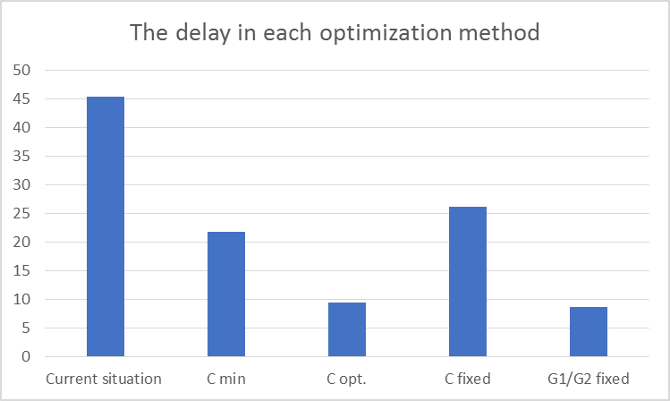
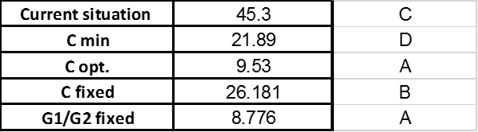
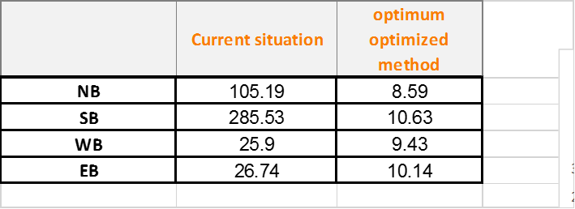
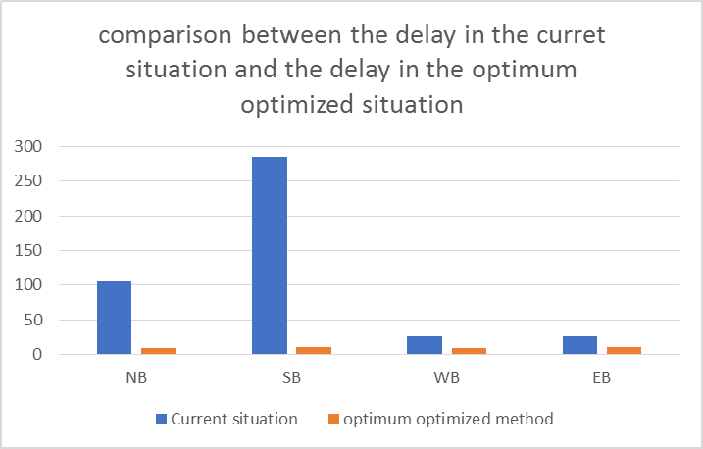

Slide 16
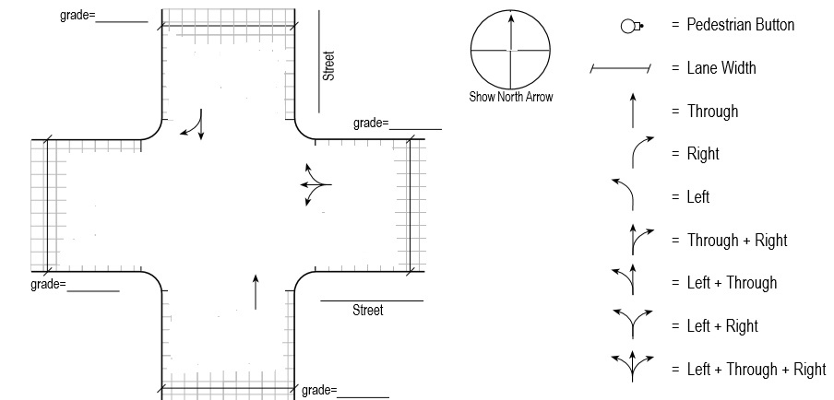
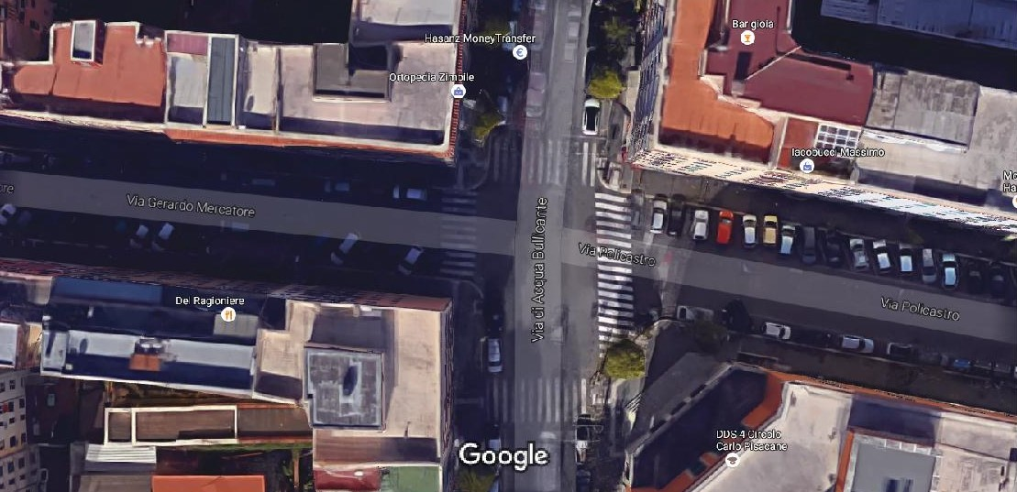
Intersection 4
 | WB | NB | SB
Delay by approach | 7.95 | 23.58 | 8.34
LOS by approach | A | C | A
Approach flow rate, Va | 89 | 172.22 | 194.44
Intersection delay | 14.03
Intersection LOS | B

Slide 17
Intersection 4
G1 | 36.58
G2 | 16.08
ACTUAL CYCLE LENGTH | 67
ACTUAL DELAY | 13.31
LOS | B
AFTER OPTIMIZATION
CYCLE LENGTH | 27
DELAY | 7.75
LOS | A
G1/G2 | 2.13385
DELAY | 11.341
LOS | B

Slide 18
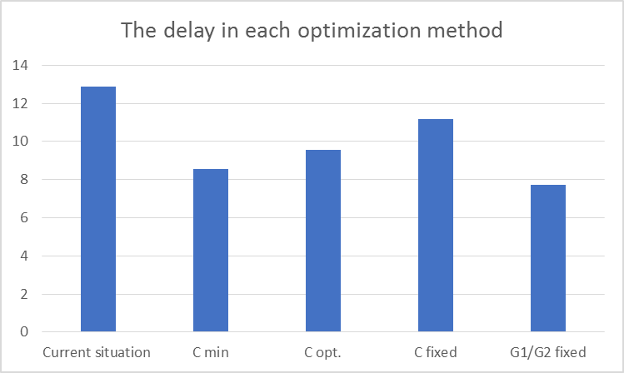
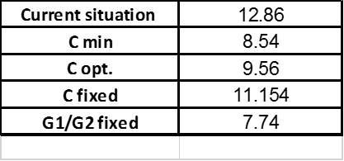
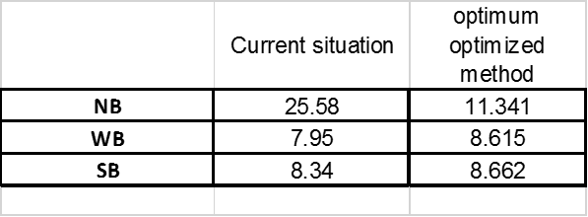
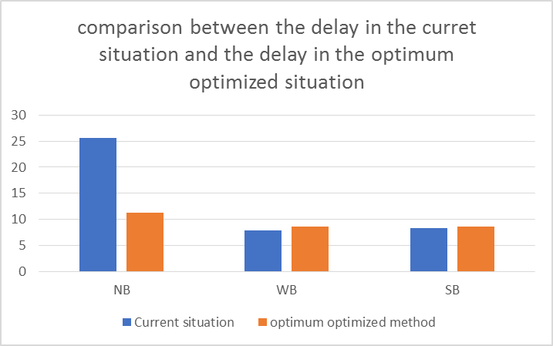

Slide 19

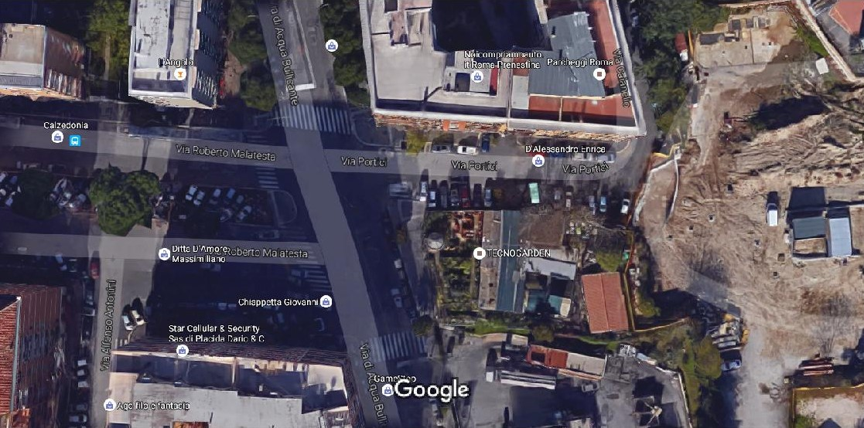
Intersection 5
 | B | NB | SB
Delay by approach | 23.89 | 11.75 | 27.09
LOS by approach | C | B | C
Approach flow rate, Va | 250 | 131 | 198
Intersection delay | 22.23
Intersection LOS | C

Slide 20
Intersection 5
g1 | 37.5
g2 | 58.5
Actual Cycle Length | 105
Actual delay | 22.23
LOS | C
After opti
C | 86
Delay | 18.26
LOS | B
G1/G2 | 2.9636
Delay | 14.34
LOS | B

Slide 21
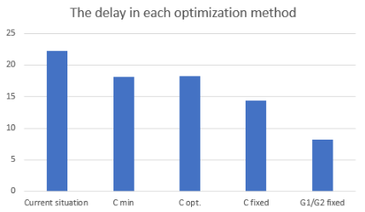
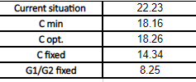
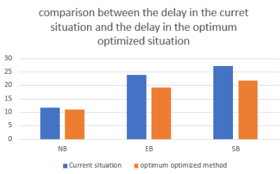
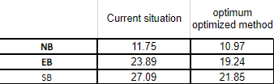

Slide 22
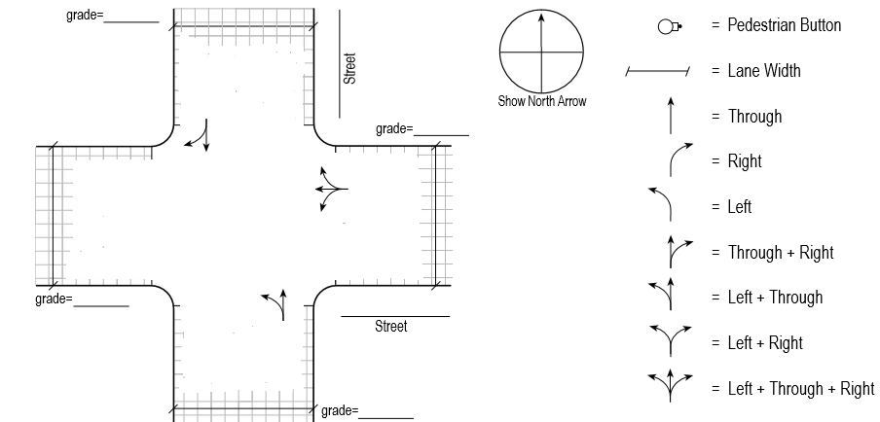
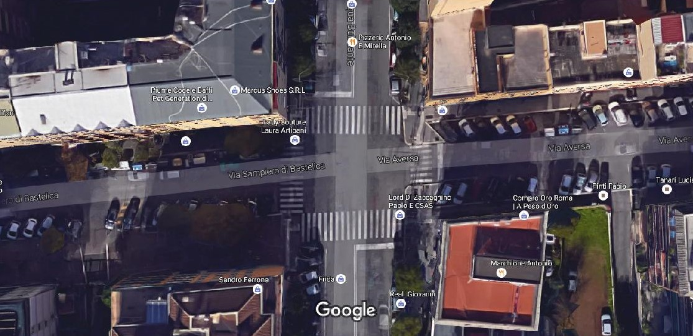
Intersection 6
 | WB | NB | SB
Delay by approach | 7.11 | 71.68 | 7.03
LOS by approach | A | E | A
Approach flow rate, Va | 470 | 390 | 384
Intersection delay | 27.33
Intersection LOS | C

Slide 23
Intersection 6
g1 | 47.5
g2 | 27
Actual Cycle Length | 79
Actual delay | 27.33
LOS | C
After opti
C | 73
Delay | 18.22
LOS | B
G1/G2 | 1.0625
Delay | 18.042
LOS | B

Slide 24
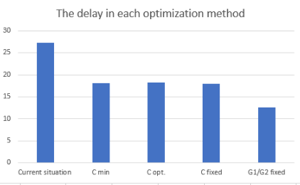

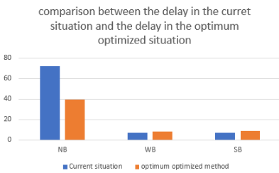
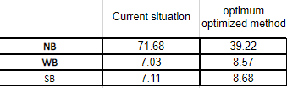

Slide 25
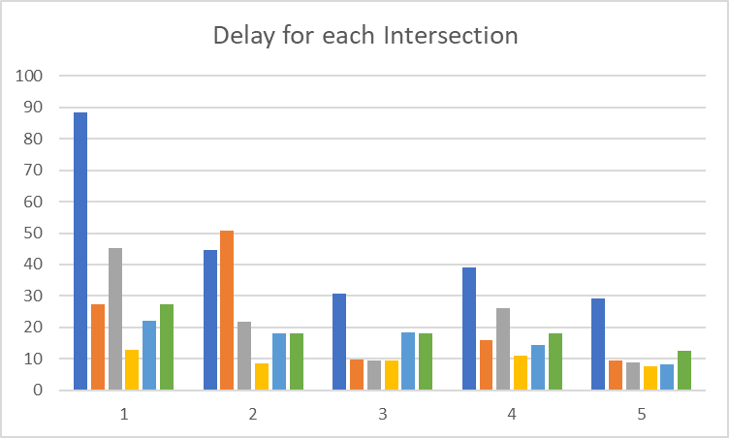
Conclusion

Slide 26
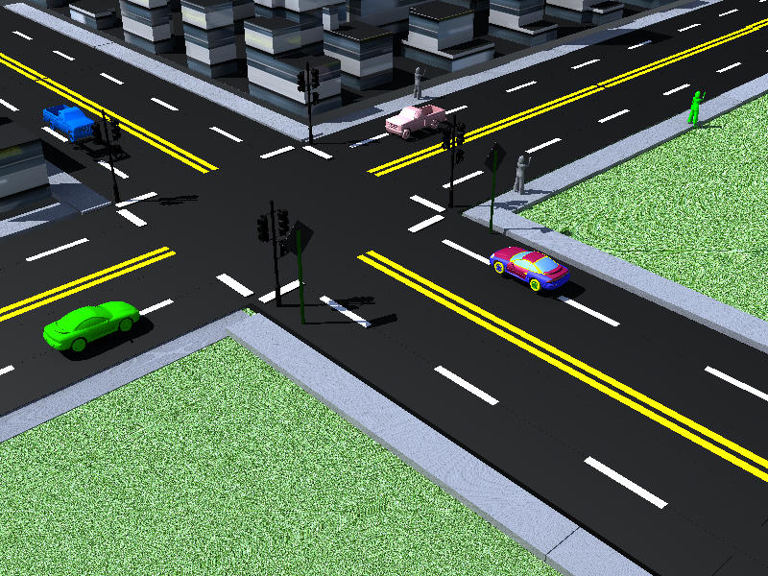
Thank you
The End

